Slide 1


Slide 2







Who is Chad Green
chadgreen@chadgreen.com
TaleLearnCode
ChadGreen.com
ChadGreen & TaleLearnCode
ChadwickEGreen

Slide 3








Who is Chad Green
IT Architecture Director
President / Conference Chair
Director of Software Development
Data & Solutions Architect
Service Delivery Manager
Project Manager
Technical Lead
Consultant
Programmer/Analyst
Programmer
Aircraft Maintenance Administration Specialist

Slide 4
Agenda
What is Conflict and Conflict Resolution
Common Approaches to Conflict Resolution
Understanding Group Dynamics
Tips for Managing Conflict

Slide 5

What is Conflict Resolution
Notes:
So what is conflict resolution?
Well let me start with the story about a man who left his three sons 17 camels.

Slide 6
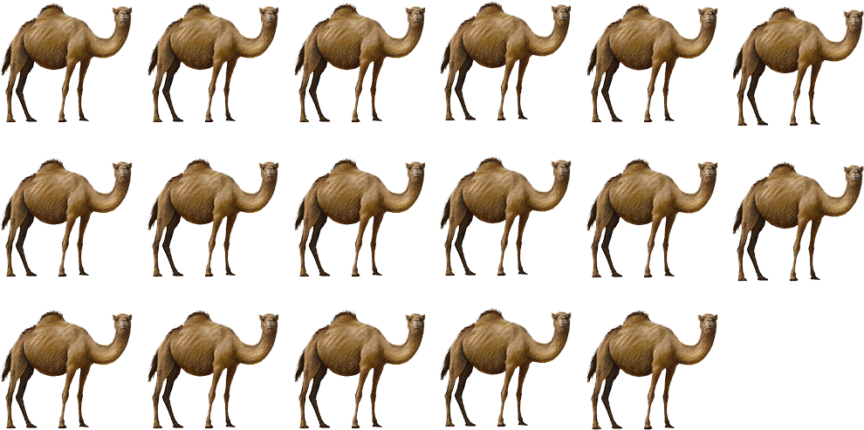
What is Conflict Resolution
Notes:
To the first son, he left half of the camels. The second was to receive a third of the camels. And the youngest was going to get a ninth of the camels.
Well the three sons get into a negotiation and 17 camels do not divide into two, doesn’t divide by three, and it doesn’t divide by nine. Tempers start to flare and in desperation they went and consulted a wise old woman.

Slide 7

What is Conflict Resolution
Notes:
This wise old woman thought about their problem for some time and finally said that since she could no longer ride her camel that she would give them the camel.

Slide 8

What is Conflict Resolution
Notes:
So now they had 18 camels. The first son took his half

Slide 9
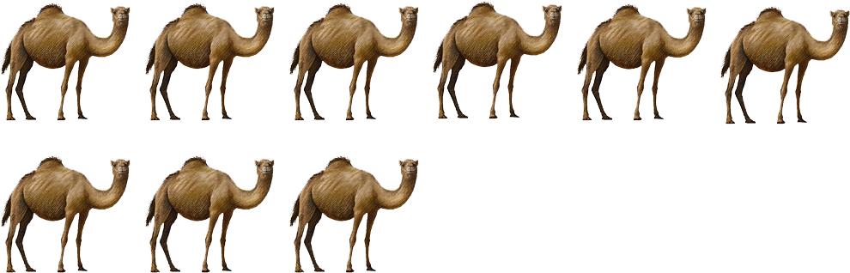
What is Conflict Resolution
Notes:
Half of 18 is 9.
The second soon took his third

Slide 10

What is Conflict Resolution
Notes:
A third of 18 is 6.
And the youngest son took his ninth

Slide 11

What is Conflict Resolution
Notes:
A ninth of 18 is 2
Low and behold,

Slide 12
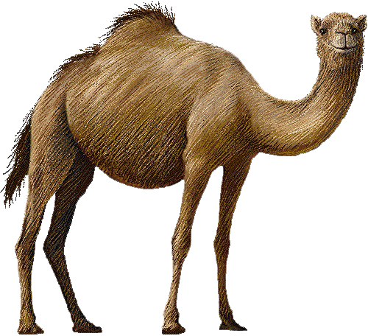
What is Conflict Resolution
Notes:
There is a camel left over.
They were able to

Slide 13

What is Conflict Resolution
Notes:
Give the old woman back her camel.
Now if you think about this story for a moment, you will see it resembles a lot of the difficult negotiations we get involved with. They start off like 17 camels with no way to resolve the problem, but somehow, we need to take a step back from the situations – like what the wise old woman did – and look at the situations through fresh eyes and come up with the 18th camel.

Slide 14
Workplace conflict
85% of US employees experience conflict and spend 2.8 hours per week dealing with it
85%
$359
Significant loss of organization productivity costs $359 billion a year
27% of employees witnessed personal attacks
27%
25%
25% say avoiding conflict results in sickness/absences
31%
78%
31% of managers think they handle conflict effectively
78% of employees disagree
95%
60%
95% of those who receive training say it is the biggest driver for success
Nearly 60% have never received training
Notes:
It’s pretty rare to work in an organization where this is no conflict or strife.
Surveys show us that 85% of U.S employees have experience conflict and spend 2.8 hours per week dealing with it.
This causes significant loss of organizational productivity ending up costing companies $359 billion a year in lost productivity. Think about that for a second. Every year, companies lost $359 billion in productivity because employees have a hard time getting along. That represents 2% of the United States’ gross domestic product and would rank 31st in the International Monetary Fund’s list of countries by GDP. That is more than the bottom 70 countries produced in 2015.
But along with those numbers, 27% of employees witnessed personal attacks
And 25% say avoiding conflict results in sickness and/or absences. SO I think that shows good evidence that we need to address conflict within the workplace.
Interestingly, 31% of managers think that they handle conflict effectively
While 78% of employees do not think their managers handle conflict effectively.
The silver lining in all of that is that 95% of those who receive training say it is the biggest driver for success. This means that there are ways to improve the situation, we just need to get people trained.
And there is the rub as nearly 60% have never received training.
One last number I want to share. I have shown that conflict costs companies lost productivity and there are other associated costs with that conflict. But conflict is also a necessary evil

Slide 15
Workplace conflict
75%
75% of employees report positive outcomes from conflict that would have not been realized without the conflict
Notes:
75% of employees report positive outcomes from conflict that would have NOT been realized with some form of conflict.

Slide 16

What is conflict?

Slide 17



What is conflict?
Good discussion about the possibilities
Not bad, but not good
Things starting to fall apart
Notes:
Now hopefully, your team conversations are something like what is depicted in this picture. This is a good discussion about the possibilities. Hopefully as the project lead, tech leader, architect, or whatever you help your team come to good conclusion by using useful conversation tools.
Team members can become very entrench in their ideas and your team conversation might be more like this. Now this is not too bad, but too many meetings like this will wear down your team. It is here where we can truly start seeing conflict. You can see the poor guy in the middle thinking, “Oh my goodness, are we really going to do this again?”
Unfortunately, conversations can get more heated and look like this. Here you can see where things are starting to fall apart. We have all probably been in a conversation that looked like this. Hopefully when you were in such a situation, someone was able to employ conflict resolution to get you back to the first image.

Slide 18
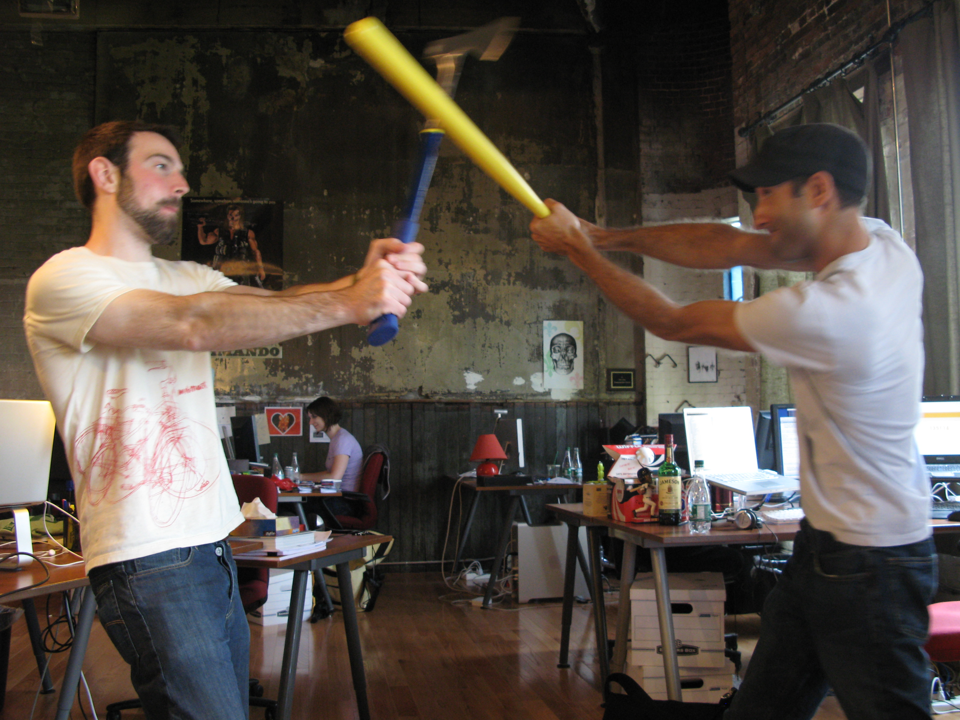
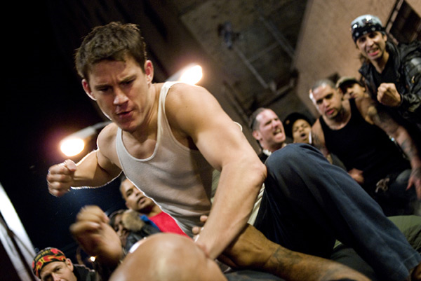
What is conflict?
Oh goodness, this cannot be good
Now this is really serious
Notes:
Now hopefully your team meetings do not come to this. Obviously, things have gotten off the rails and even if someone is not physically hurt, there will be deep wounds on the team. Of course, I guess it could get worse
Now in all seriousness, you’ll probably never see more than the images on the previous slide. But not addressing conflict early could result in something more serious.

Slide 20
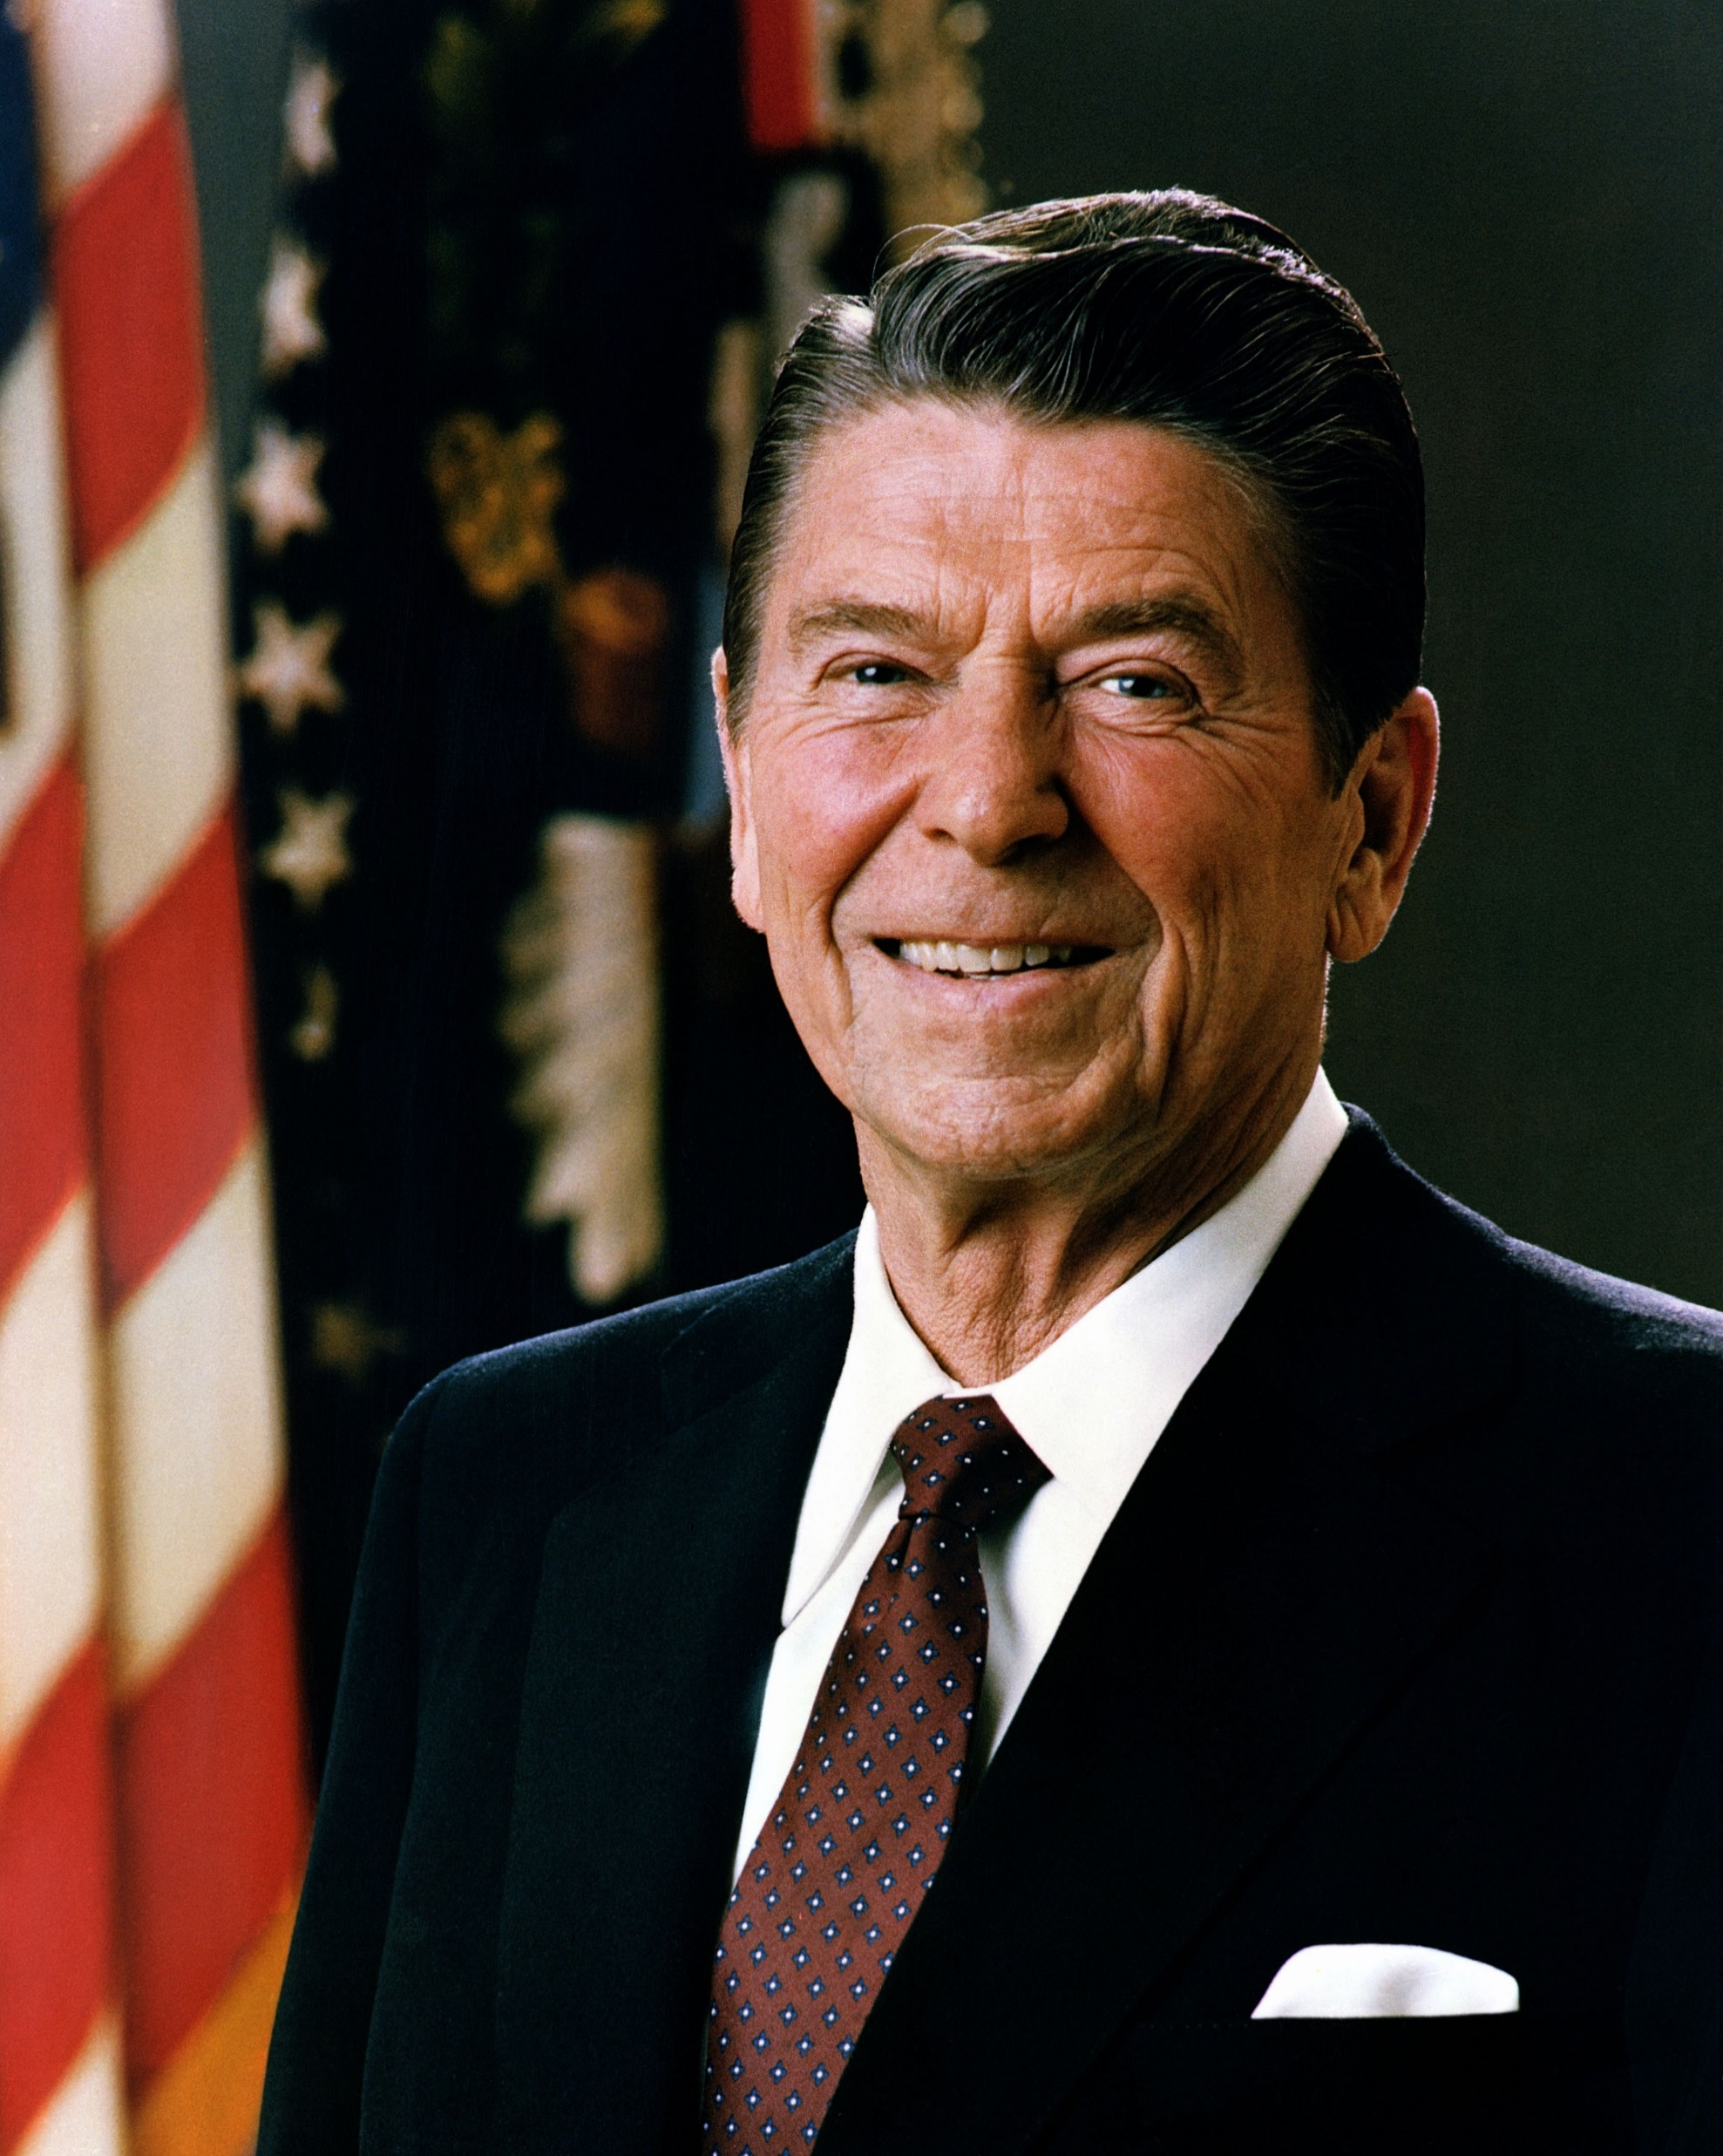
Peace is not the absence of conflict, it is the ability to handle conflict by peaceful means.
Ronald Regan

Slide 21
Approaches to Conflict Resolution
Secrets of Conflict Resolution
Notes:
An appreciation of conflict resolution approaches is integral to understanding the communication process. While the names may differ slightly, there are five major responsive approaches to managing conflict. There is no right or wrong conflict resolution approach, and each conflict participant is capable of choosing the approach they deem most appropriate in a given situation. In the workplace, a leader should understand each of these approaches to help parties resolve conflicts that arise on the job.

Slide 22

Collaboration
Problem Solving
Confronting
Integrating
Notes:
The first approach we are going to look at is Collaboration which is also referred to as problem solving, confronting, and integrating.

Slide 23

Collaboration
Multiple viewpoints and insights from different perspectives
Notes:
PMI defines collaboration as incorporating multiple viewpoints and insights from different perspectives.
In this technique, the parties openly discuss differences and try to incorporate multiple viewpoints in order to lead to a consensus.

Slide 24
Collaboration
Multiple viewpoints and insights from different perspectives
Rational problem solving
Notes:
This approach involves a rational problem-solving approach. More succinctly, this approach has disputing parties solve their differences by first

Slide 25
Collaboration
Multiple viewpoints and insights from different perspectives
Rational problem solving
Focusing on the issues
Notes:
focusing on the issues, then

Slide 26
Collaboration
Multiple viewpoints and insights from different perspectives
Rational problem solving
Focusing on the issues
Looking at alternative approaches
Notes:
looking at alternative approaches, and finally

Slide 27
Collaboration
Multiple viewpoints and insights from different perspectives
Rational problem solving
Focusing on the issues
Looking at alternative approaches
Selecting best alternative
Notes:
selecting the best alternative.
This approach involves open and direct communication which should lead the way to solving the problem at hand.

Slide 28
Collaboration
Win/Win
Multiple viewpoints and insights from different perspectives
Rational problem solving
Focusing on the issues
Looking at alternative approaches
Selecting best alternative
Notes:
As such, this is considered to be a win-win approach.
So, what are examples of when collaborating maybe appropriate?

Slide 29

Collaboration
When to use?
Consensus and commitment is important
Notes:
Whole point of collaboration is getting consensus with everyone, so obviously a good time to use is when consensus and commitment of all parties is important. If done correctly; you will have a win-win solution.

Slide 30
Collaboration
When to use?
Consensus and commitment is important
Collaborative environment
Notes:
Obviously when working in a collaborative environment

Slide 31
Collaboration
When to use?
Consensus and commitment is important
Collaborative environment
Address interest of multiple stakeholders
Notes:
If you need to address the interest of more than one stakeholder, then collaborating is going to be the way to go – Army ROTC example

Slide 32
Collaboration
When to use?
Consensus and commitment is important
Collaborative environment
Address interest of multiple stakeholders
High level of trust is present
Notes:
If you need to address the interest of more than one stakeholder, then collaborating is going to be the way to go – Army ROTC example

Slide 33
Collaboration
When to use?
Consensus and commitment is important
Collaborative environment
Address interest of multiple stakeholders
High level of trust is present
Long-term relationship is important
Notes:
Hand-in-hand with trust is long-term relationships. Collaboration helps continue trust between parties.

Slide 34
Collaboration
When to use?
Consensus and commitment is important
Collaborative environment
Address interest of multiple stakeholders
High level of trust is present
Long-term relationship is important
Work through hard feelings, animosity, etc.
Notes:
Need to work through hard feelings, animosity, etc. Even a group that has worked well with each other will have some strife. Because collaborating involves focusing on issues TOGETHER and selecting the best alternative TOGETHER, it is a good approach.

Slide 35
Collaboration
When to use?
Consensus and commitment is important
Collaborative environment
Address interest of multiple stakeholders
High level of trust is present
Long-term relationship is important
Work through hard feelings, animosity, etc.
Do not want full responsibility
Notes:
When you do not want to have full responsibility. Example: project manager working with developers on tech issues

Slide 36
Collaboration
Advantages
Solves the actual problem
Notes:
So now that we have looked at when is a good time to use the collaboration approach, let’s look at some of its advantages.
First and foremost, the collaboration approach leads to solving the actual problem. You are discussing what the issue is and alternatives to the solution which, by doing so, will allow you to solve the actual problem at hand. As you will see with some of the other approaches, you are not necessary solving the problem that caused the conflict.

Slide 37
Collaboration
Advantages
Solves the actual problem
Win-Win outcome
Notes:
Because you are getting all sides to agree with the solution, you get a win-win outcome.

Slide 38
Collaboration
Advantages
Solves the actual problem
Win-Win outcome
Reinforces mutual trust and respect
Notes:
Because all sides work together, the collaboration approach promotes mutual trust and respect among the different parties.

Slide 39
Collaboration
Advantages
Solves the actual problem
Win-Win outcome
Reinforces mutual trust and respect
Foundation for effective collaboration
Notes:
Because all sides work together, the collaboration approach promotes mutual trust and respect among the different parties.

Slide 40
Collaboration
Advantages
Solves the actual problem
Win-Win outcome
Reinforces mutual trust and respect
Foundation for effective collaboration
Shared responsibility
Notes:
There is a shared responsibility in the resulting outcome

Slide 41
Collaboration
Advantages
Solves the actual problem
Win-Win outcome
Reinforces mutual trust and respect
Foundation for effective collaboration
Shared responsibility
Earn the reputation of good negotiator
Notes:
One moderating will get reputation of a good negotiator and will encourage future cooperation

Slide 42
Collaboration
Advantages
Solves the actual problem
Win-Win outcome
Reinforces mutual trust and respect
Foundation for effective collaboration
Shared responsibility
Earn the reputation of good negotiator
Outcome is less stressful
Notes:
General rule, the outcome will be less stressful.

Slide 43
Collaboration
Disadvantages
Requires commitment from all parties
Notes:
Requires a commitment from all parties

Slide 44
Collaboration
Disadvantages
Requires commitment from all parties
May require more effort and time
Notes:
May require more time and effort – takes time to review the issue and then look at alternative solutions.

Slide 45
Collaboration
Disadvantages
Requires commitment from all parties
May require more effort and time
Not practical when timing is critical
Notes:
May not be practical when timing is crucial; managing e-commerce app with outage 2-hours before massive Black Friday sale

Slide 46
Collaboration
Disadvantages
Requires commitment from all parties
May require more effort and time
Not practical when timing is critical
Must continue collaborative efforts
Notes:
Collaboration requires that involved parties must continue collaborative efforts to maintain a collaborative relationship

Slide 47

Compromise
Give and take
Reconciling
Notes:
Next, we have the Compromise approach. This is also referred to as a “give and take” approach or reconciling.

Slide 48

Compromise
Bargain to reach a mutually acceptable solution
Lose/Lose
Notes:
With this approach, conflicting parties bargain to reach a mutually acceptable solution. Both parties give up something in order to reach a decision an leave with some degree of satisfaction.
This is considered to be a lose-lose situation, since no party gets everything they wanted.
So why would you use the compromising approach, well because sometimes a lose-lose situation is what the doctor calls for.

Slide 49

Compromise
When to Use?
Both parties need to win
Notes:
If sold right, this can look as if post parties win and there are times where that is just the case. Examples 2 weeks/4 weeks.

Slide 50
Compromise
When to Use?
Both parties need to win
Goals are moderately important
Notes:
Goals are only moderately important and not worth the use of a more assertive or more involved approaches

Slide 51
Compromise
When to Use?
Both parties need to win
Goals are moderately important
Temporary settlement on complex issues
Notes:
Maybe you need an expedient solution on a complex issue where you do not have time to do a more elaborate approach. Think back to the e-commerce example.

Slide 52
Compromise
When to Use?
Both parties need to win
Goals are moderately important
Temporary settlement on complex issues
Expedient solutions on important issues
Notes:
Maybe you need an expedient solution on a complex issue where you do not have time to do a more elaborate approach. Think back to the e-commerce example.

Slide 53
Compromise
When to Use?
Both parties need to win
Goals are moderately important
Temporary settlement on complex issues
Expedient solutions on important issues
Involved parties do not know each other
Notes:
Collaboration pretty much requires relationships; compromising can work better with parties that do not know each other

Slide 54
Compromise
When to Use?
Both parties need to win
Goals are moderately important
Temporary settlement on complex issues
Expedient solutions on important issues
Involved parties do not know each other
When collaboration or forcing does not work
Notes:
When collaboration or forcing do not work.

Slide 55
Compromise
Advantages
Faster issue resolution
Notes:
It will generally generate a faster resolution to your issue. Because you are not looking at the root of the issues and doing analysis like you would with collaboration, this approach should procude faster results than some of the other approaches.

Slide 56
Compromise
Advantages
Faster issue resolution
Provides a temporary solution
Notes:
Can provide a temporary solution while looking for a win-win solution.

Slide 57
Compromise
Advantages
Faster issue resolution
Provides a temporary solution
Lowers tension and stress
Notes:
Lowers the level of tension and stress resulting from the conflict.

Slide 58
Compromise
Disadvantages
Both parties are not satisfied
Notes:
Both parties are not satisfied

Slide 59
Compromise
Disadvantages
Both parties are not satisfied
Does not build trust
Notes:
Using the compromise approach does not contribute to building trust in the long run. Both sides will have the tendency to think that they gave up too much so trust Is not built up.

Slide 60
Compromise
Disadvantages
Both parties are not satisfied
Does not build trust
Close monitoring and control
Notes:
May require close monitoring and control to ensure agreements are met.

Slide 61

Accommodation
Smoothing
Obliging
Notes:
Next, we have Accommodation which is also referred to as smoothing or obliging.

Slide 62
Accommodation
Areas of agreement are emphasized
Areas of disagreement are downplayed
Lose/Win
Notes:
In this approach, the areas of agreement are emphasized and the areas of disagreement are downplayed. The approach emphasized cooperation instead of assertiveness. A person places their interest last and allows the other party to further their interests. The accommodation approach often occurs when a party is not significantly invested in securing a victory, because they do not perceive the alternative option as a significant threat.
Simply put, this approach is accommodating the concerns of other people first of all, rather than one’s own concerns. This technique emphasizes agreement rather than differences of opinion.
Here’s an analogy to explain what accommodation is: When driving in traffic, I often see someone who is playing a zero-sum game, for whom their objective in life is to get ahead of you – at all costs – regardless of who has the right of way. A lot of times if I detect an aggressive driver like this, I will slow down and let the other person get in front of me because in reality, I am not playing the same games as the other driver. My objective is to keep traffic flowing smoothly and not be in a Fast and Furious outtake and end up in the hospital – or worse!

Slide 63

Accommodation
When to use?
Provide a temporary relief or buy time
Notes:
Important to provide a temporary relief from a conflict or buy time until you are in a better to respond or push back

Slide 64
Accommodation
When to use?
Provide a temporary relief or buy time
Issue not as important to you
Notes:
When the issue is not as important to you as the other person. Think about the analogy of the other drive that just had to get in front of me.

Slide 65
Accommodation
When to use?
Provide a temporary relief or buy time
Issue not as important to you
You accept you are wrong
Notes:
When you accept you are wrong. Saying: sometimes you have to shut up, swallow your pride, and accept that you are wrong. It’s not giving up, its called growing up.

Slide 66
Accommodation
When to use?
Provide a temporary relief or buy time
Issue not as important to you
You accept you are wrong
You have no choice/continued competition would be detrimental
Notes:
When you have no choice or when continued competition would be detrimental.

Slide 67
Accommodation
Advantages
Protects more important interest
Notes:
In some cases, accommodation will help to protect more important interests while giving up on some less important ones. Someone is going to lose something, but if what is being lost is of less importance than what is gained, then there is a big benefit to gaining that big advantage. Go back to my driving analogy.

Slide 68
Accommodation
Advantages
Protects more important interest
Opportunity to reassess the situation
Notes:
Gives an opportunity to reassess the situation from a different angle. This is especially true when you are resolving a conflict that you are directly involved in. By basically giving up what you want and letting the other get what they want, you will be in a good position to see the situation from the other person’s view.

Slide 69
Accommodation
Disadvantages
Risk of being abused
Affects your confidence
More difficult to transition to win-win
Notes:
Make it more difficult to transition to a win-win solution in the future. While not always possible, I think we all wish we could get to a win-win solution but the accommodation approach provides a lose-win solution – someone has to “lose” in order for the accommodation approach to be successful. So let’s say you have used the accommodation approach to get a temporary solution in order to get work done with the thought that after a major deadline you will go back and work on a win-win solution using maybe the collaboration approach. Or maybe you realized what is better is a lose/lose solution because in the end that is what is better for the team so you want to try to use the comprise approach. Well once one side has won, it will be that much harder to get them back to the table and possibility “lose” what they have already have “won”.

Slide 70
Accommodation
Disadvantages
Risk of being abused
Affects your confidence
More difficult to transition to win-win
Some supporters may not like your response
Notes:
Some of your supporters may not like your accommodation response and be turned off. I have seen it personally where I used accommodation because I needed a quick solution so my team can get back to what is important – work – and I will see where others not involved did not like my response. This is especially true for my project managers as they might not like that someone won while someone lost; or more importantly, they might not like WHO won. Now when this does happen, you have to work it out with those supporters so that they understand why you want down one path instead of another.

Slide 71

Force
Directing
Competing
Controlling
Dominating
Notes:
Force – also known as directing, competing, controlling, or dominating.

Slide 72

Force
Pushing viewpoint at expense of another
Notes:
This technique involves pushing one’s viewpoint at the expense of another and will generate a win-lose solution. When using this approach, an individual firmly pushes their own concerns despite the resistance of the other person.

Slide 73
Force
Pushing viewpoint at expense of another
Assertiveness is hallmark
Notes:
Assertiveness is the hallmark of this approach, and those employing this approach

Slide 74
Force
Win/Lose
Pushing viewpoint at expense of another
Assertiveness is hallmark
Addresses conflict head-on
Notes:
aim to address the conflict head-on. It might involve high levels of emotions as the parties establish positions in what can sometimes evolve into hostile communications.

Slide 75

Force
When to use?
Other methods do not work
Notes:
Well the obvious time is when all other, less forceful methods, do not work or are ineffective. So if you have been working long on hard on getting collaboration, compromise, or even accommodation to work with no luck then you are probably going to have to resort to using the Force approach in order to get the conflict resolved and get people back working.

Slide 76
Force
When to use?
Other methods do not work
Stand up for your rights
Notes:
When you need to stand up for you own rights and resist aggression and pressure from others. As leaders, there are times when we need to assert our professional needs over others. Generally you have become a leader because you are trusted professional and you have earned the right and have the experience to be right. But be careful when using this approach when standing up for yourself as perception can quickly change and you are viewed as a dictator.

Slide 77
Force
When to use?
Other methods do not work
Stand up for your rights
Quick resolution is required
Notes:
When a quick resolution is required and using force is justified. For example, you might use the force approach in a life-threatening situation or to stop an aggression.

Slide 78
Force
When to use?
Other methods do not work
Stand up for your rights
Quick resolution is required
Last resort to long-lasting conflict
Notes:
As a last resort to resolve a long-lasting conflict. Maybe you have entered a conflict that has been going on for a long time and if that conflict continues it could be detrimental to the project or people’s well beings. Well then maybe you just need to start with the force approach to resolve that conflict that has been going on for a long time.

Slide 79
Force
Advantages
Quick resolution
Notes:
May provide a quick resolution to a conflict. There is not a lot of back and forth discussion from the different sides – actually there might not be any discussion – so this approach has a tendency to generate results pretty quickly.

Slide 80
Force
Advantages
Quick resolution
Increases self-esteem/respect
Notes:
It will increase self-esteem and draws respect when the action is a response to an aggression or hostility. The self-esteem part is obvious since the one using the technique is getting what they want. But you might be saying to me that even if you get some respect by using this approach, that respect is probably short lived. Well that can be the case, but not always. Example of Ferdinand Marcos – 1986 uprising.

Slide 81
Force
Disadvantages
Negatively affect relationship
Notes:
May negatively affect your relationship with the opponent in the long run. Just like in my example with President Marcos, he continued to use the force approach and it caused strife among the people to the point that there was public demonstration and the city of Manila was overrun by opposition. You have to be careful when using this approach to not become a dictator.

Slide 82
Force
Disadvantages
Negatively affect relationship
Opponent reacts in same way
Notes:
May cause the opponent to react in the same way, even if the opponent did not intend to be forceful originally. There is the concept of the flight-or-fight response which is a physiological reaction that occurs in response to a perceived harmful event, attack, or threat to survival. While some might fly away from future conflict, others will see this as a threat to their survival and might retaliate back using the same approach to you.

Slide 83
Force
Disadvantages
Negatively affect relationship
Opponent reacts in same way
Lots of energy
Notes:
May require a lot of energy and be exhausting to some individuals. Look it can be a while lot easier to use something like the accommodation approach to resolve conflict. Because there can be some resistance – at least at first – this can be tiring to the one enacting the technique.

Slide 84
Force
Disadvantages
Negatively affect relationship
Opponent reacts in same way
Lots of energy
Cannot take advantage of other side’s position
Notes:
Actually more important in my mind. Using the force approach does not take advantage of the strong points of the other side’s position. You are probably not even listening at what the other side has to say. And if you do, you are not taking any advantage of their solutions.

Slide 85

Withdrawal
Avoidance
Notes:
Finally we have the Withdrawal approach, which is also known as avoidance.

Slide 86

Withdrawal
Retreat or postpone a decision on a problem
Notes:
In this technique, the parties retreat or postpone a decision on a problem.

Slide 87
Withdrawal
Retreat or postpone a decision on a problem
Not best choice for resolving conflict
Notes:
Dealing with problems is a PMI-ism; therefore, withdrawal is not usually not the best choice for resolving conflict, though there may situations where it is necessary.

Slide 88
Withdrawal
Retreat or postpone a decision on a problem
Not best choice for resolving conflict
Not giving up – sidestepping or postponing
Notes:
Note that this is not giving up, it’s just sidestepping or postponing the issue.

Slide 89

Withdrawal
When to use?
Trivial issue not worth effort
Notes:
Well there are more times than you would think and I’m not including because you are lazy – which would be a bad reason to withdraw from a conflict.
Issue is trivial and not worth the effort. Conflict come in all shapes and sizes and there are those that will not warrant your attention.

Slide 90
Withdrawal
When to use?
Trivial issue not worth effort
More important pressing issues
Notes:
When more important issues are pressing and you do not have time to deal with it. Again, if you are leader of some sort, then you live a busy life and just do not have time to get into every little conflict.

Slide 91
Withdrawal
When to use?
Trivial issue not worth effort
More important pressing issues
When postponing response is beneficial
Notes:
In situations where postponing the response is beneficial to you. For example, it might not be the right time or place to confront the issue or you need more time to think and collect information before you act. This is actually a pretty common use of the withdrawal approach – or at least it should be. Example of technical debt.

Slide 92
Withdrawal
When to use?
Trivial issue not worth effort
More important pressing issues
When postponing response is beneficial
No chance of getting concerns met
Notes:
When you see no chance of getting your concerns met or you would have to put forth unreasonable efforts.

Slide 93
Withdrawal
When to use?
Trivial issue not worth effort
More important pressing issues
When postponing response is beneficial
No chance of getting concerns met
Have to deal with hostility
Notes:
There are times when the appropriate solution would cause hostility and you need to avoid that, so using the withdrawal approach would make sense there.

Slide 94
Withdrawal
When to use?
Trivial issue not worth effort
More important pressing issues
When postponing response is beneficial
No chance of getting concerns met
Have to deal with hostility
Unable to handle conflict
Notes:
When you are unable to handle the conflict such as when you are too emotionally involved or another can handle it better. If you are emotionally involved in a situation, then it’s probably better to take a step back and let someone else come in.

Slide 95
Withdrawal
Advantages
Postpone until you are in a more favorable circumstance
Notes:
When the opponent is forcing or attempting aggression, you may choose to withdraw and postpone your response until you are in more favorable circumstance for you to push back.

Slide 96
Withdrawal
Advantages
Postpone until you are in a more favorable circumstance
Low stress approach
Notes:
Withdrawing is a low stress approach when the conflict is short. There are times when we see that the conflict is going to be a short one; so instead of creating a bunch of stress trying to solve the conflict, the withdrawal approach provides a way to lower the stress all around.

Slide 97
Withdrawal
Advantages
Postpone until you are in a more favorable circumstance
Low stress approach
Ability/time to focus on more important/urgent issues
Notes:
Withdrawal approach gives you the ability and time to focus on more important or more urgent issues instead. Like I have said, you will have all sorts of conflicts come your way and they do not all desrve the same level of attention.

Slide 98
Withdrawal
Advantages
Postpone until you are in a more favorable circumstance
Low stress approach
Ability/time to focus on more important/urgent issues
Time to be better prepared
Notes:
Withdrawal approach gives you time to better prepare and collect information before you act.

Slide 99
Withdrawal
Disadvantages
Lead to weaking or losing position
Notes:
The biggest disadvantage is that using this technique may lead to weakening or losing your position; not acting may be interpreted as an agreement. Using withdrawing strategies without negatively affecting your own position requires certain skill and experience. You do not want to be considered weak, as you will no longer be a leader.

Slide 100
Withdrawal
Disadvantages
Lead to weaking or losing position
Interpreted as agreement
Notes:
Interpreted as agreement

Slide 101
Withdrawal
Disadvantages
Lead to weaking or losing position
Interpreted as agreement
Negatively affect relationship with others
Notes:
When multiple parties are involved, withdrawing may negatively affect your relationship with a party that expects your action. In my role, I see conflicts between developers and project mangers and there are times where if I do not act – even though it might be in mine or the team’s best interest - it can cause one of those sides to feel slighted by my “lack” of action.

Slide 102
Exercise
Notes:
Finally we have the Withdrawal approach, which is also known as avoidance.

Slide 103
Exercise
“Do it my way!”
Force

Slide 104
Exercise
“Let’s calm down and get the job done!”
Accommodation

Slide 105
Exercise
“Let us do a little of what both of you suggest.”
Compromise

Slide 106
Exercise
“Let’s deal with this issue next week.”
Withdrawal

Slide 107
Exercise
“Pat and Amanda, both of you want this project to cause as little distraction to your departments as possible. With that in mind, I am sure we can come to be agreement on the purchase of equipment and what is best for the project.”
Accommodation

Slide 108
Exercise
“We have talked about new computers enough. I do not want to get the computers, and that is it!”
Force

Slide 109
Exercise
“Pat, you say the project should include the purchase of new computers, and Amanda, you say the project can use existing equipment. I suggest we perform the following test on the existing equipment to determine if it needs to be replaced.”
Collaboration

Slide 110
Exercise
“Let’s see what everyone things, and try to reach a consensus.”
Collaboration

Slide 111
Exercise
“Since we cannot decide on the purchase of new computers, we will have to wait until our meeting next month.”
Withdrawal

Slide 112
Exercise
“Pat, what if we get new computers for the design activity on the project and use the existing computers for the monitoring functions?”
Compromise

Slide 113
Understanding Group Dynamics
Secrets of Conflict Resolution
Notes:
Now that we have an understanding of the common approaches to conflict management, let’s look at some group dynamics.

Slide 114
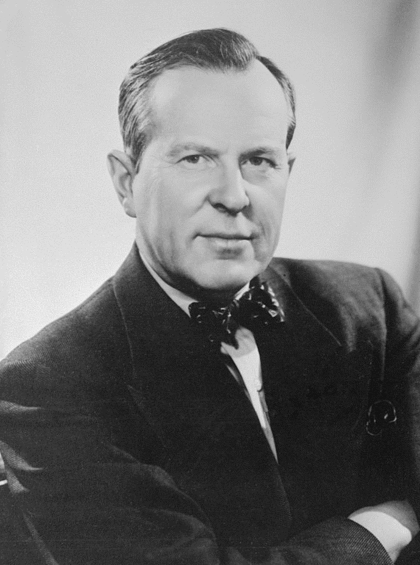
How can there be peace without people understanding each other; and how can this be if they don’t know each other?
Lester B. Pearson
Notes:
It is pretty hard to resolve conflict among groups of people if you do not have a general understanding of how people work and how group dynamics work.
Transactional analysis is a psychoanalytic therapy wherein social transactions are analyzed to determine the ego state of the patient as a basis for understanding behavior. As I only have an hour, I’m not going deep into psychoanalysis, but I am going to talk about an important tool within this type of analysis.

Slide 115
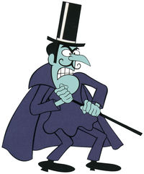
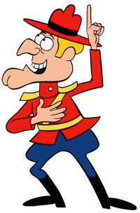

Karpman Drama Triangle
Persecutor
Rescuer
Victim
Notes:
Conflict has a predictable pattern known as the drama triangle which was first introduced by Dr. Steven Karpman. The basic concept underpinning the Karpman Drama Triangle is the connection between responsibility and power, and the destructive and shifting roles people play.
He defined three roles in conflict, Persecutor, Rescuer, and Victim and placed these roles on an inverted triangle and referred to them as being the three aspects (or faces) of drama. He had interests in acting and chose the term “drama triangle” rather than the term of “conflict triangle” as the Victim in his model is not intended to represent an actual victim, but rather someone feeling or acting like a victim.
So, let’s take a quick look at these roles

Slide 116
Karpman Drama Triangle
Persecutor
Rescuer
Victim
Notes:
The Persecutor insists, “It’s all your fault.” The Persecutor is controlling, blaming, critical, oppressive, angry, authoritative, rigid, and superior.
The Rescuer’s line is “Let me help you.” A classic enabler, the Rescuer feels guilty if they do not go to the rescue. Yet their rescuing has negative effects as it keeps the Victim dependent and gives the Victim permission to fail.
The Victim’s stance is “Poor is me!” The Victim feels victimized, oppressed, helpless, hopeless, powerless, ashamed, and seems unable to make decisions, solve problems, take pleasure in life, or achieve insight. The Victim, if not being persecuted, will seek out a Persecutor and also a Rescuer who will save the day but also perpetuate the Victim’s negative feelings.

Slide 117
Karpman Drama Triangle
Persecutor
Rescuer
Victim
Notes:
Initially, a drama triangle arises when a person takes on the role of a victim or persecutor. This person then feels the need to enlist other players into the conflict. These enlisted players take on roles of their own that are not static, and therefore various scenarios can occur. For example, the victim might turn on the rescuer, the rescuer then switches to persecuting – or as often happens, a rescuer is encouraged to enter the situation.

Slide 118

Little Red Riding Hood
Karpman Drama Triangle

Slide 119
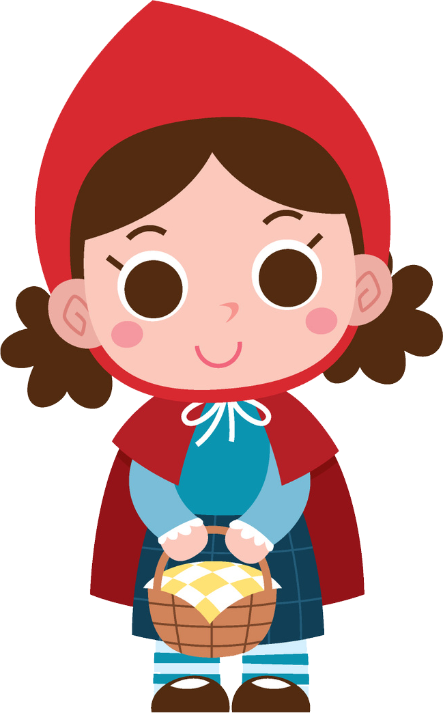
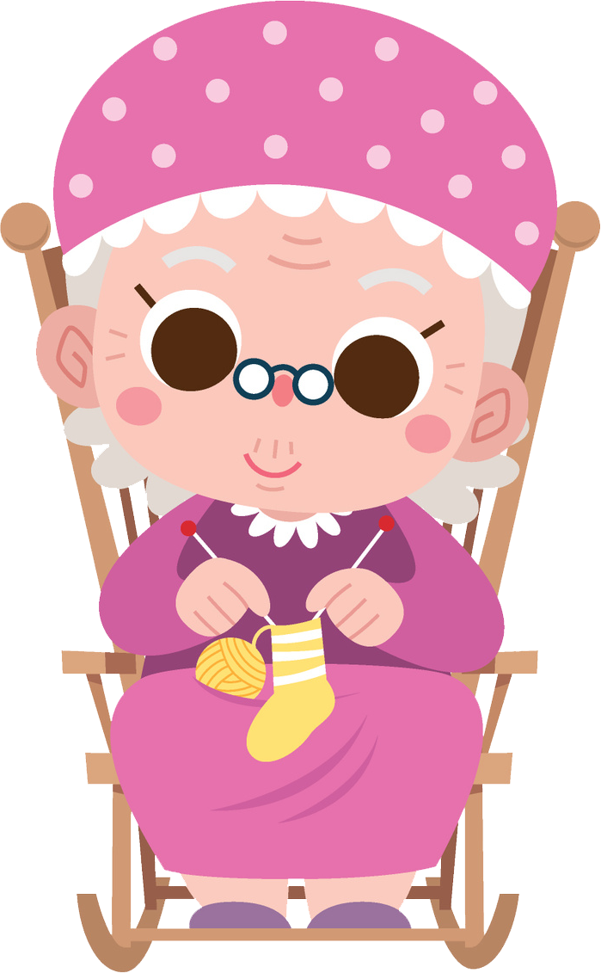
Little Red Riding Hood
Notes:
Once upon a time there was a dear little girl who was loved by everyone who looked at her, but most of all by her grandmother, and there was nothing that she would not have given to the child. Once she gave her a little cap of red velvet, which suited her so well that she would never wear anything else. So she was always called Little Red Riding Hood.
One day her mother said to her, “Come, Little Red Riding Hood, here is a piece of cake and a bottle of wine. Take them to your grandmother, she is ill and weak, and they will do her good. Set out before it gets hot, and when you are going, walk nicely and quietly and do not run off the path, or you will fall and break the bottle, and then your grandmother will get nothing. And when you go into her room, don’t forget to say, good-morning, and don’t pee into every corner before you do it.”
I will take great care, said Little Red Riding Hood to her mother, and gave her hand on it.

Slide 120
Little Red Riding Hood
Notes:
The grandmother lived out in the wood, half a league from the village

Slide 121

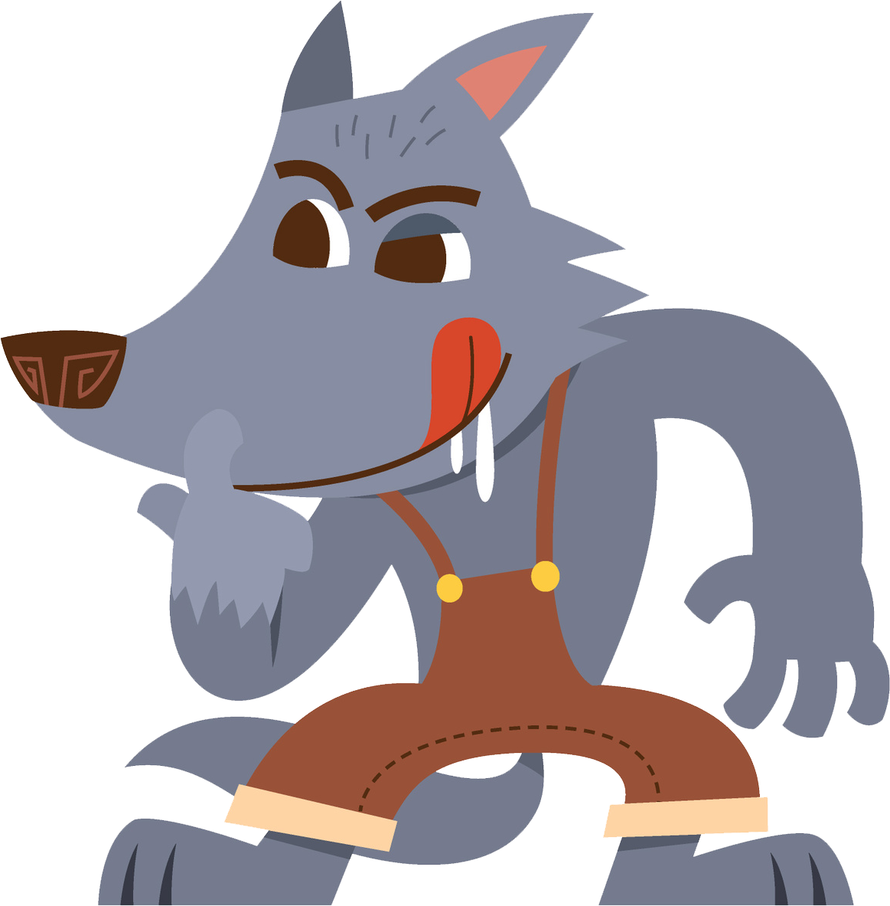
Little Red Riding Hood
Notes:
The grandmother lived out in the wood, half a league from the village, and just as Little Red Riding Hood entered the wood, a wolf met her. Little Red Riding Hood did not know what a wicked creature he was, and was not at all afraid of him.
“Good-day, Little Red Riding Hood”, said he.
“Thank you kindly, wolf.”
“Wither away so early, Little Red Riding Hood?”
“To my grandmother’s”
“What have you got in your apron?”
“Cake and wine. Yesterday was baking-day, so poor sick grandmother is to have something good, to make her stronger.”
“Where does your grandmother live, Little Red Riding Hood?”
“A good quarter of a league farther on in the wood. Her house stands under the three large oak-trees, the nut-trees are just below. You surely must know it,” replied Little Red Riding Hood.
The wolf thought to himself, “What a tender young create. What a nice plump mouthful, she will be better to eat than the old woman. I must act craftily, so as to catch both.” So he walked for a short time by the side of Little Red Riding Hood, and then he said, “see Little Red Riding Hood, how pretty the flowers are about here. Why do you not look round. I believe, too, that you do not hear how sweetly the little birds are singing. You walk gravely along as if you were going to school, while everything else out here in the wood is merry.”

Slide 122

Little Red Riding Hood
Notes:
Little Red Riding Hood raised her eyes, and when she saw the sunbeams dancing here and there through the trees, and pretty flowers growing everywhere, she thought, suppose I take grandmother a fresh nosegay. That would please her too. It is so early in the day that I shall still get there in good time. And so she ran from the path into the wood to look for flowers. And whenever she had picked one, she fancied that she saw prettier one farther on, and rand after it, and so got deeper and deeper into the wood.

Slide 123

Little Red Riding Hood
Notes:
Meanwhile the wolf ran straight to the grandmother’s house and knocked at the door.
“Who is there?”
“Little Red Riding Hood,” replied the wolf. “She is bringing cake and wine. Open the door.”
“Lift the latch,” called out the grandmother, “I am too weak, and cannot get up.”
The wolf lifted the latch, the door sprang open, and without saying a word he went straight to the grandmother’s bed, and devoured her. Then he put on her clothes, dressed himself in her cap, laid himself in the bed and drew the curtains.

Slide 124
Little Red Riding Hood
Notes:
Little Red Riding Hood, however, had been running about picking flowers, and when she had gathered so many that she could carry no more, she remembered her grandmother, and set out on her way to her.

Slide 125
Little Red Riding Hood
Notes:
She was surprised to find the cottage-door standing open, and when she went into the room, she had such a strange feeling that she said to herself, oh dear, how uneasy I feel today, and at other times I like being with grandmother so much.
She called out, “Good morning,” but received no answer. So she went to the bed and drew back the curtains.

Slide 126
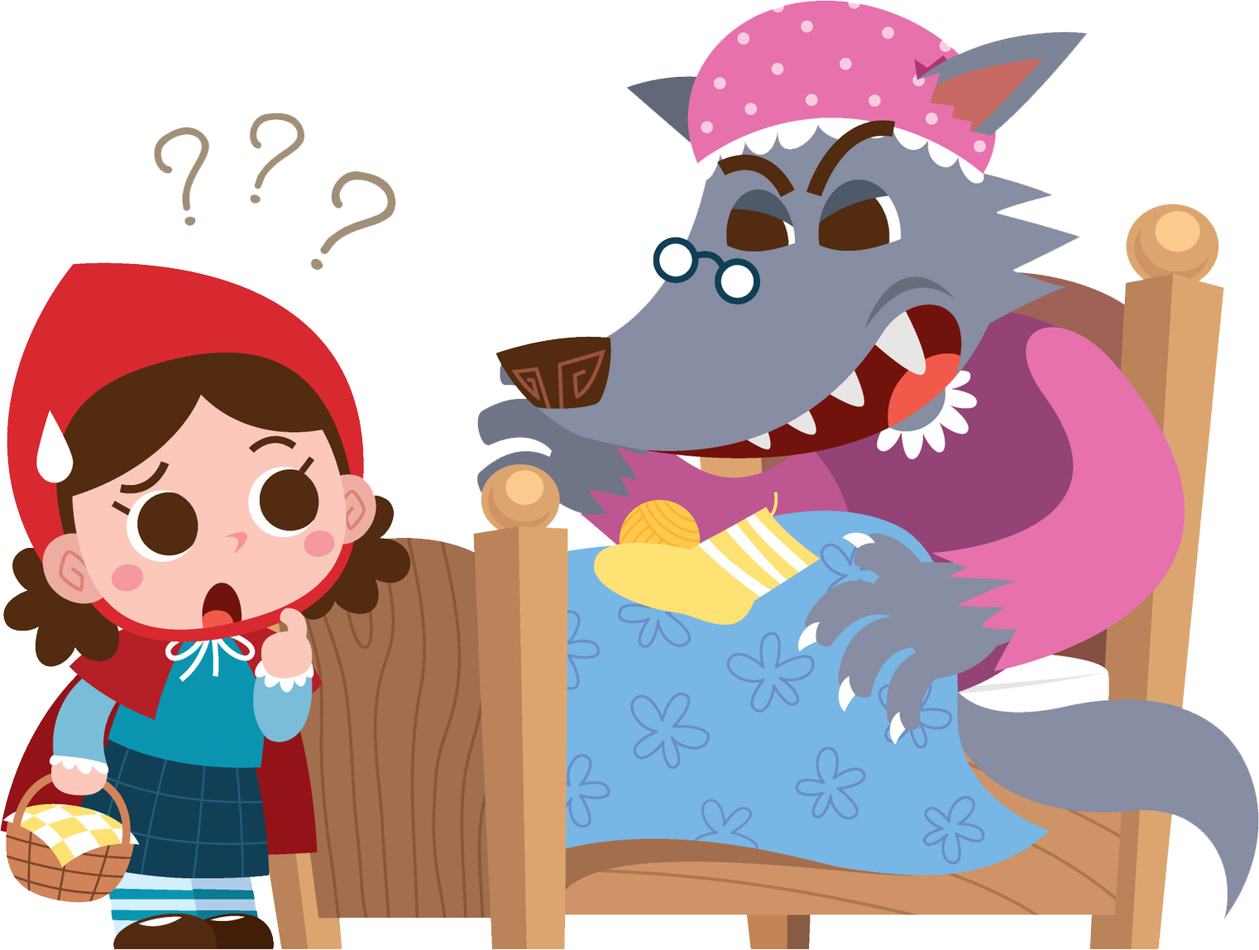
Little Red Riding Hood
Notes:
There lay her grandmother with her cap pulled far over her face, and looking very strange.
“Oh, grandmother,“ she said, “what big ears you have.”
“The better to hear you with, my child,” was the reply.
“But, grandmother, what big eyes you have,” she said.
“The better to see you with, my dear.”
“But, grandmother, what large hands you have.”
“The better to hug you with.”
“Oh, but, grandmother, what a terrible big mouth you have.”
“The better to eat you with.”
And scarcely had the wolf said this, than with one bound he was out of bed and swallowed up Little Red Riding Hood.
When the wolf had appeased his appetite, he lay down again in the bed, fell asleep and began to snore very loud.

Slide 127
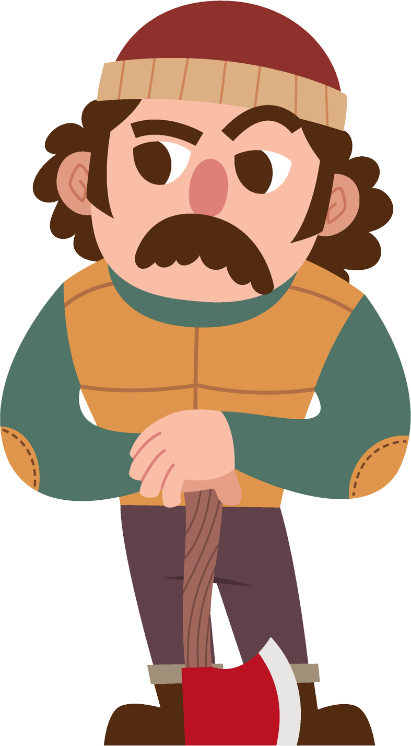
Little Red Riding Hood
Notes:
The huntsman was just passing the house, and thought to himself, how the old woman is snoring., I must just see if she wants anything.
So he went into the room, and when he came to the bed, he saw that the wolf was lying in it. “Do I find you here, you old sinner,” said he. “I have long sought you.”

Slide 128
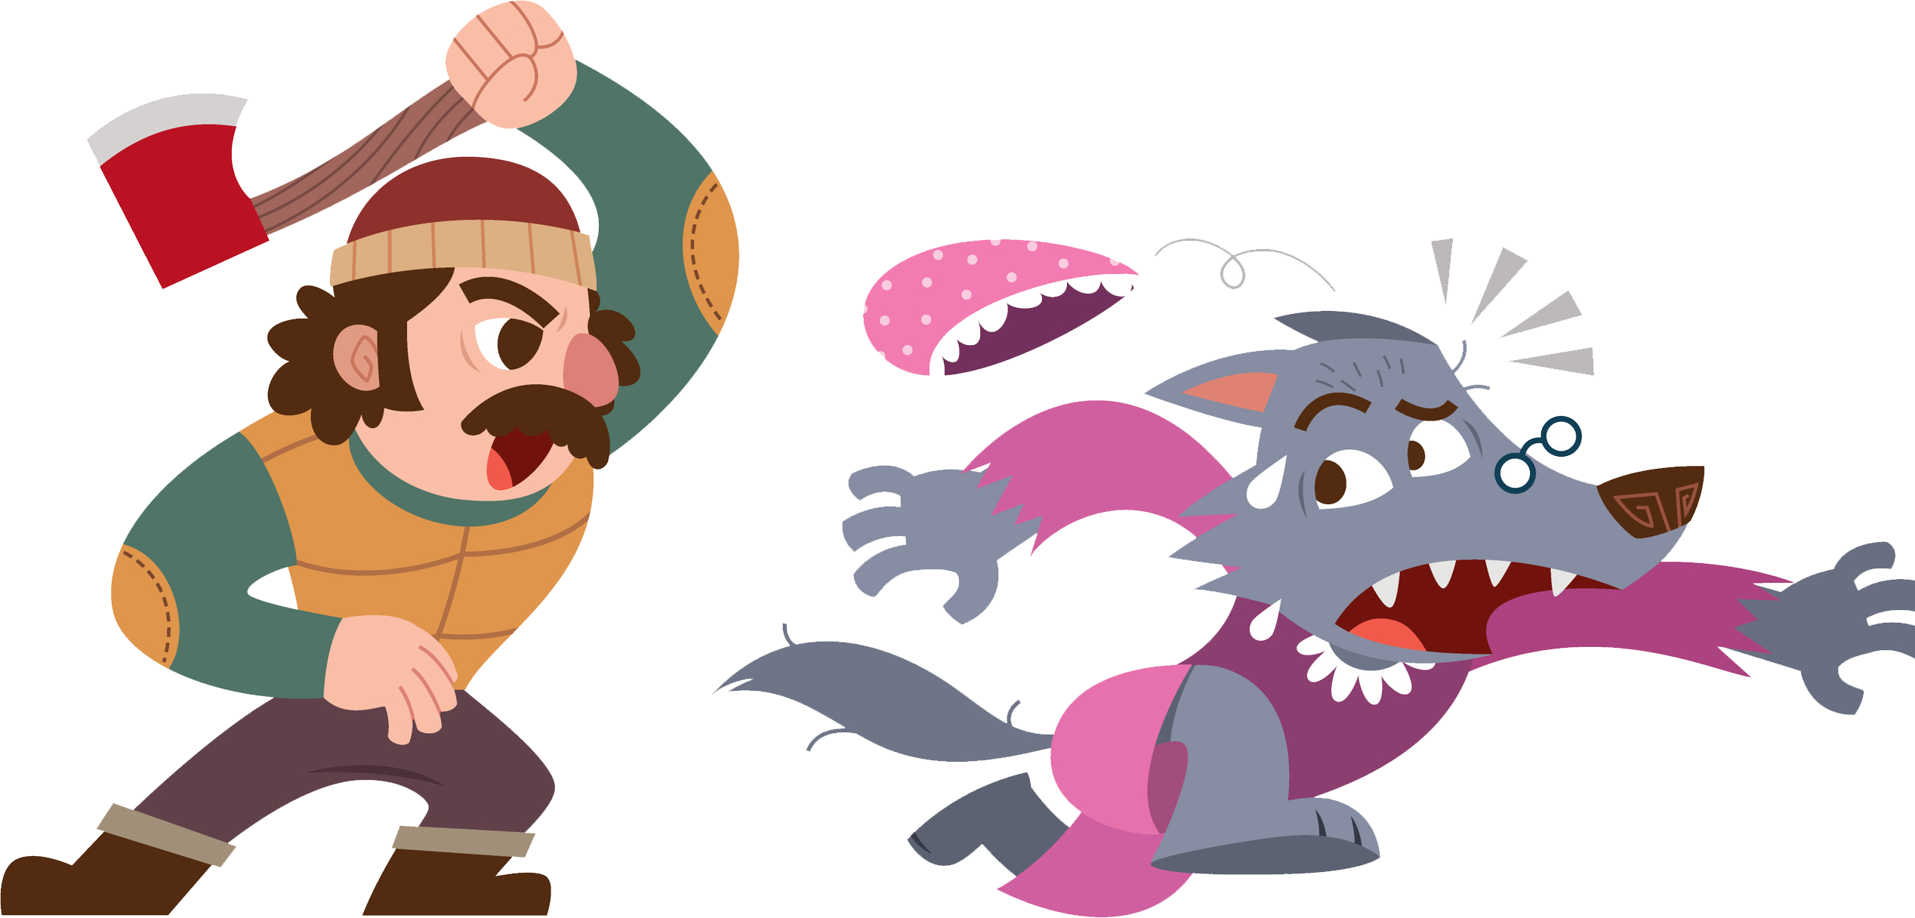
Little Red Riding Hood
Notes:
Then just as he was going to fire at him, it occurred to him that the wolf might have devoured the grandmother, and that she might still be saved, so he did not fire, but took a pair of scissors, and began to cut open the stomach of the sleeping wolf.
When he had made two snips, he saw the Little Red Riding Hood shining, and then he made two snips more, and the little girl sprang out, crying, “Ah, how frightened I have been. How dark it was inside the wolf.”
And after that the aged grandmother came out alive also, but scarcely able to breath. Little Red Riding Hood, however, quickly fetched great stones with which they filled the wolf’s belly, and when he awoke, he wanted to run away, but the stones were so heavy that he collapsed at once, and fell dead.

Slide 129
Little Red Riding Hood
Notes:
Then all three were delighted. The huntsman drew off the wolf’s skin and went home with it. The grandmother ate the cake and drank the wine which Little Red Riding Hood had brought, and revived, but Little Red Riding Hood thought to herself, as long as I live, I will never by myself leave the path, to run into the wood, when my mother has forbidden me to do so.

Slide 130
Little Red Riding Hood - Analysis
Rescuer
Victim
Persecutor
Notes:
In the story, Little Red Riding Hood starts as a Rescuer by taking food and company to grandmother and providing friendship and directions to the wolf.
In a suspense switch she becomes Victim to the wolf.
At the end of the story, Little Red Riding Hood winds up as a Persecutor by sewing stones in the wolf’s belly with the woodsman.

Slide 131
Little Red Riding Hood - Analysis
Persecutor

Slide 132
Little Red Riding Hood - Analysis
Victim

Slide 133
Little Red Riding Hood - Analysis
Persecutor
Rescuer
Notes:
Playing two roles

Slide 134
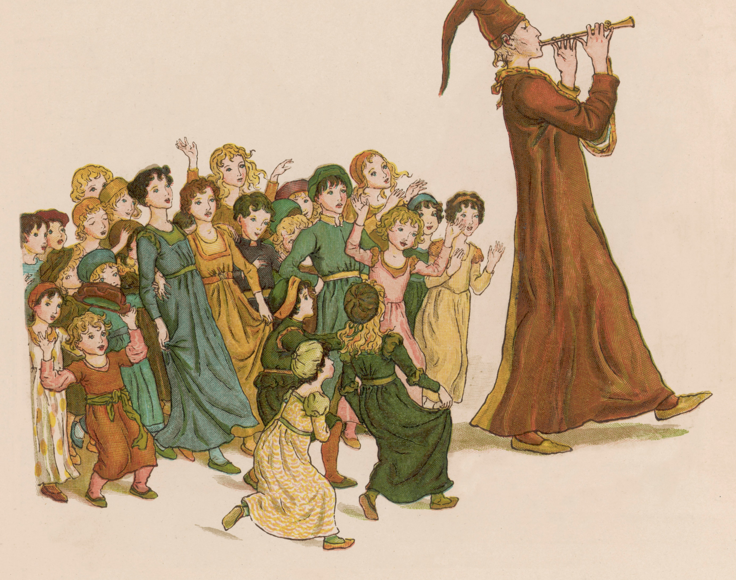
Pied Piper
Karpman Drama Triangle

Slide 135
Pied Piper - Analysis
Rescuer
Persecutor
Victim
Persecutor
Pied Piper
Victim
Rescuer
Persecutor
Victim
Mayor
Persecuted Victim
Rescued Victim
Victims Persecuted
Children
Notes:
In the story, the Pied Piper begins as the Rescuer of the city and the Persecutor of the rates. He then becomes Victim to the Persecutor mayor’s double-cross (fee withheld), and in revenge, switches to the Persecutor of the city’s children.
The mayor switches from Victim (of rats), to Rescuer (hiring the Pied Piper), to Persecutor (double-cross), to Victim (his children dead).
The children switch from Persecuted Victims (rates) to Rescued Victims, to Victims Persecuted by their Rescuer (increased contrast).

Slide 136
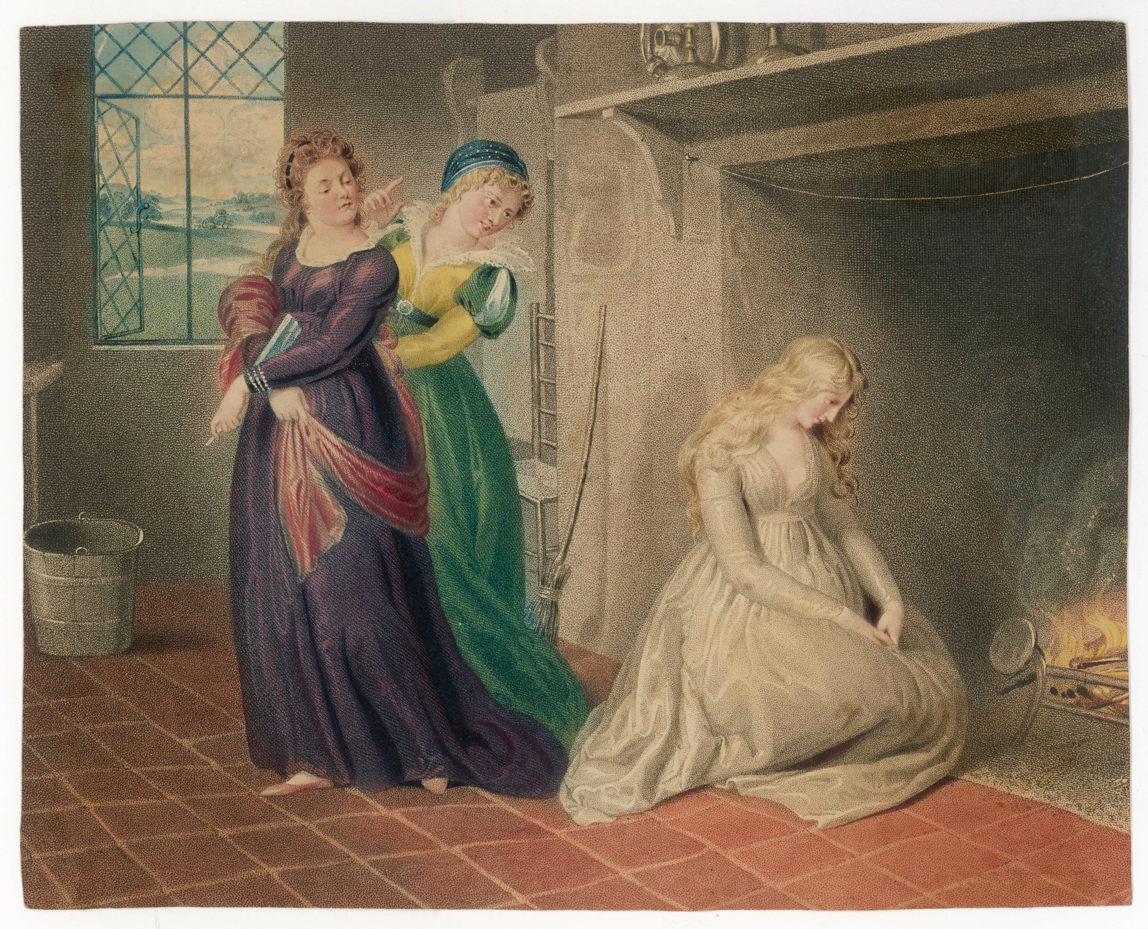
Cinderella
Karpman Drama Triangle

Slide 137
Cinderella - Analysis
Persecuted Victim
Rescued Victim
Persecuted Victim
Rescued Victim
Notes:
In Cinderella, the heroine switched from Victim double Persecuted (mother then stepsisters), to Victim tripled Rescued (Fairy godmother than mice then prince), to Victim Persecuted again (after midnight) then Victim Rescued again.

Slide 138

Software Development Team
Karpman Drama Triangle

Slide 139


Software Development Team Scenario
Bob
Alice
Notes:
A project manager, Bob, is working with a software development team on a new project. The team is under pressure to meet tight deadlines, and Bob is feeling stressed and overwhelmed. He notices that one team member, Alice, is not pulling her weight and is falling behind on her tasks.

Slide 140
Software Development Team Scenario
Bob
Persecutor
Bob
Alice
Alice
Victim
Notes:
Bob, playing the role of the “Persecutor,” begins to criticize Alice and assign blame for the delays in the project. Alice, playing the role of the “Victim,” feels attacked and becomes defensive, feeling that her contributions are not valued.

Slide 141
Software Development Team Scenario
Alice
Bob
Rescuer
Persecutor
Alice
Victim
Notes:
Bob, playing the role of the “Persecutor,” begins to criticize Alice and assign blame for the delays in the project. Alice, playing the role of the “Victim,” feels attacked and becomes defensive, feeling that her contributions are not valued.
In response, Alice begins to play the role of the “Rescuer,” taking on extra work and trying to make up for the her perceived shortcomings. This only adds to her stress and puts even more pressure on the already strained project.
The situation spirals out of control, with Bob and Alice each playing their assigned roles and perpetuating the conflict.

Slide 142





Software Development Team Scenario
Alice
Bob
Rescuer
Persecutor
Alice
Victim
Notes:
The rest of the team becomes caught in the middle, unsure of how to resolve the tension and move forward.
To resolve this situation, it is important to step out of the Karpman Drama Triangle and find a more collaborative and solution-focused approach. This might involve brining in a mediator, having an open and honest conversation between Bob and Alice, and establishing clear communication and teamwork protocols to prevent similar conflicts in the future. By breaking the pattern of the drama triangle, the team can work together more effectively and avoid similar conflicts in the future.

Slide 143
Managing Conflicts
Secrets of Conflict Resolution
Notes:
Now that we have given an overview of what conflict and conflict resolution is, talked about the 5 primary approaches to conflict resolution, and about the group within a conflict; let’s cover some tips that will make you a superstar when it comes to resolving conflict.
10 Tips to Make You a Conflict Resolution Superstar

Slide 144

Tackle the issue after both parties have calmed down
10 Tips to Make You a Conflict Resolution Superstar
Notes:
First, tackle the issue after both parties have calmed down. The absolute worst time to try to get all sides of a conflict to think rationally about something is right as everything is blowing up. You want to address the issue early, before it turns into a bigger problem, but be sure to wait until things have cooled down. It is difficult to have a productive decision if those involved are angry or upset. Wait until everyone is clear-headed. Maybe that means taking a 10-minute break, breaking for lunch, or scheduling a separate meeting. But whatever it is, give everyone to change to cool off.

Slide 145

Maintain a positive outlook
10 Tips to Make You a Conflict Resolution Superstar
Notes:
Maintain a positive outlook. Do not assume the other party is hostile or unwilling to work out a solution. If you are entering the conversation with negative expectations, you may unwittingly elicit the very reactions you are trying to avoid. Keep an open mind throughout and try not to assume that the other parties will be unreceptive to your concerns. Try talking directly with the person you are having the conflict with. Meet in a neutral place, remain calm, and treat the other person with respect.
If you a manager or leader dealing with conflict among your team, this even more important. If the team sees you do not have a positive feeling that the conflict resolution solution will be beneficial to the team as a whole, then their hearts will not be in it.

Slide 146

Practice active listening
10 Tips to Make You a Conflict Resolution Superstar
Notes:
Practice active listening. When you approach another party about something you do not agree about, do not just fire off concerns. Hear them out. Pay attention, ask questions, try to understand thee other group’s perspective, and acknowledge the emotions that all sides are experiencing. When discussing the conflict, focus on the behaviors needed for resolution. This will keep the discussion focused on the issue or problem, rather than turning it into a personality clash that may further escalate the conflict.

Slide 147
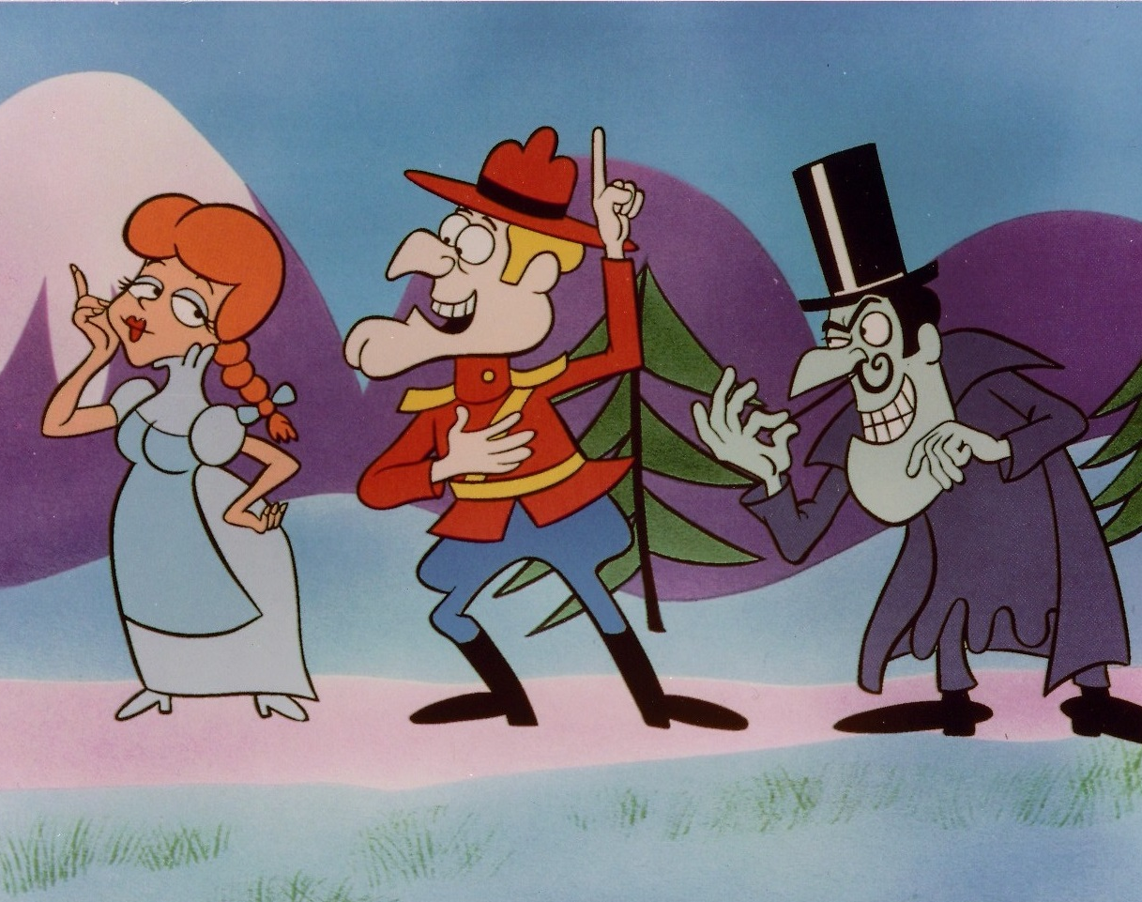
Consider your role in the conflict
10 Tips to Make You a Conflict Resolution Superstar
Notes:
Conflict your role in the conflict. So where do you fit in to the conflict. Did you start something you probably did not mean? Or even if you meant it, maybe you should not have started it anyway. Maybe you are the victim, you just wanted to get your work peer reviewed and that started a holy war of whether the team should be using spaces or tabs. Or just maybe you came in to be the rescuer – and that can be good or bad depending on the purpose of the recue.
Understanding where you fit in the conflict will take you further down the path of how to resolve the issue.

Slide 148

Organize a staff meeting
10 Tips to Make You a Conflict Resolution Superstar
Notes:
Let’s think about the peer review example I just said. Let’s assume you have two developers performing a peer review at one of their desks and an all-out battle ensures about whether to use tabs or spaces in their code. And for the non-developers in the room, that really does happen; although not as often as it used to. As a project manger you hear what’s going on and you can see that this is just going to get worse. Well why not pull everyone into a collaboration room and discuss it. You probably will advert a real conflict quickly, meaning that it will probably be worth a few moments than to have these two developers made for the rest of the day.

Slide 149

Seek first to understand
10 Tips to Make You a Conflict Resolution Superstar
Notes:
Seek first to understand. Try not to jump to conclusions. Many conflicts originate as simple misunderstandings, misinterpretations, and missed opportunities to clarify another’s intentions. You can mitigate or altogether avoid so many of your daily conflicts by simply seeking first to understand those with whom you interact with. While simple, however, this mindset is not common or even encouraged in our fast-paced workplaces. Workers can illuminate their understanding of a conflict by honing their listening skills asking clarifying questions, and earnestly seeking other’s underlying interests. This simple action not only stops its escalation; it opens the doors for early and lasting resolutions as well.

Slide 150

Alert human resources
10 Tips to Make You a Conflict Resolution Superstar
Notes:
Alert human resources. If you are battling an issue as serious as workplace harassment, the problem might require intervention from someone higher up. When direct attempts and mediation are not effective, you may have to pursue formal channels. Talk to your supervisor and human resources and follow your organization’s formal procedures for filing a complaint. Document the problem in writing, being specific about what behaviors occurred, when they happened what impact they had, and what needs to be done to resolve conflict.
Really simple; no matter what level you are, you do not want to go it alone when it comes to workplace harassment. Doing so will just cause you more grief than you would ever want.

Slide 151

Find a mediator
10 Tips to Make You a Conflict Resolution Superstar
Notes:
Find a mediator. Some workplace clashes turn into all out battles worthy of a war movie. If you find yourself locked into a fight, it may be time for the groups to bring in a mediator.
You can introduce the conflict to a mediator formally or informally. An informal meeting with an objective person who all sides respect can help you talk through problem without the formalities (and potential subsequent consequences) of a formal mediation.
If an informal meeting does not put the issue to rest, you may need to contact a supervisor for help in resolving the conflict. If you choose a formal mediation, be sure on your best professional behavior. Do not attack your opponent. Present the conflict in objective terms and not as an emotional reaction to someone who happens to have an opposing viewpoint.
In a formal mediation, expect enlightenment. A third-party observer may be quick to point out failings in your argument that you just could not accept from a co-worker. And that is the beauty of mediation – it helps being the conflict to an objective, level playing field that is fairer for everyone.

Slide 152
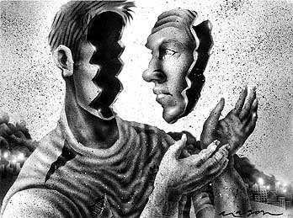
Be introspective
10 Tips to Make You a Conflict Resolution Superstar
Notes:
Be introspective. Conflicts arise in every workplace, and personality clashes abound in all of them. Conflict is inevitable – plan for the future. In the aftermath of a conflict, take some time to consider how you manage your emotions. How do you experience stress or anger? What triggers set you off? How do you tend to react in the face of conflict? What coping skills do you use? Are they healthy use? Use this self-awareness to make a plan for handling conflict better the net time one arises.
Each conflict is an opportunity for growth. Therefore, you should reflect and readjust after one occurs. Conflicts provide the opportunities to better appreciate another perspective, clarify your own interests, strengthen bonds, and discover new ways forward. Internalizing these experiences and growing from them allows you to face tomorrow’s difficulties with grater ease and effectiveness.

Slide 153
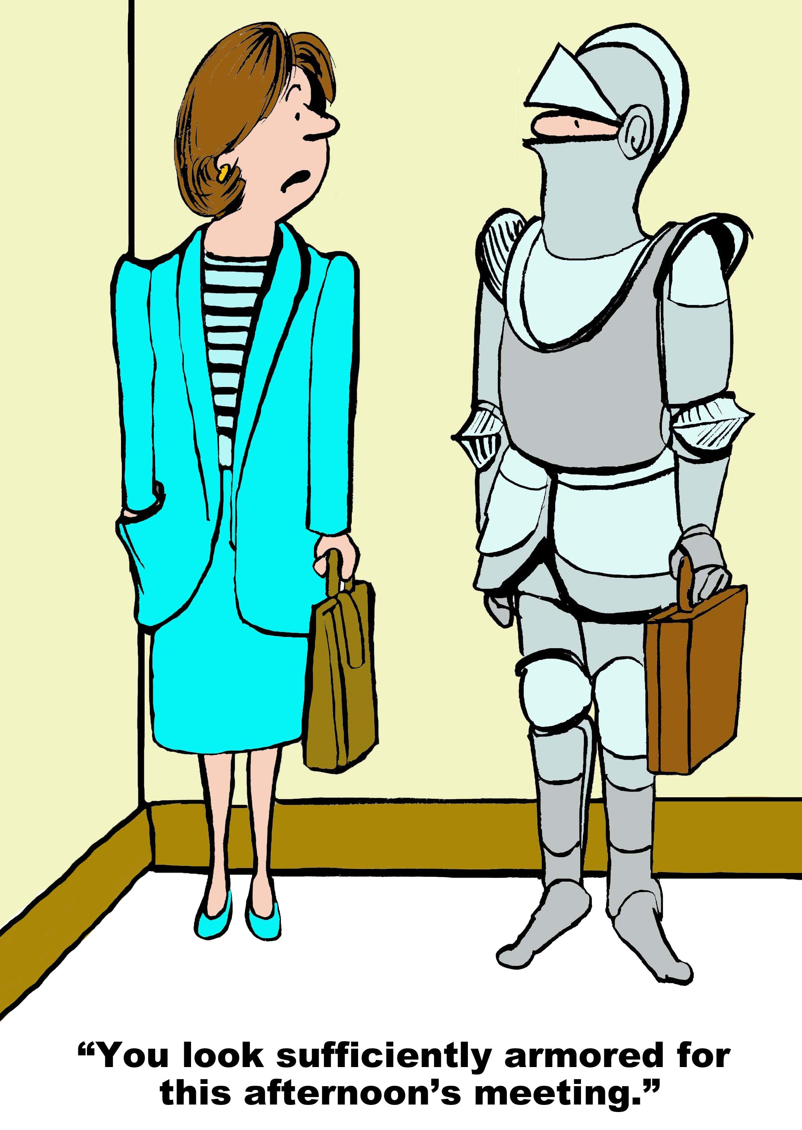
Expect conflict
10 Tips to Make You a Conflict Resolution Superstar
Notes:
Finally, expect conflict. A conflict-free workspace would be beautiful place indeed. However, it is just not possible to avoid conflict entirely. You have to learn to expect that conflict will become a part of your work life at some point.
The real imperative is learning to deal with conflict in a productive way. Do not let disagreements gather momentum and turn into major crises. Instead, address them as soon as possible. Resolve them instead of letting them fester.
Of course, for many people, avoidance or passive-aggressiveness is a more course of action. But fearing or avoiding conflict tends to make edgy situations much worse.
As you work to manage the problem, make sure that the conflict is totally resolved for all sides. If you feel triumphant but you co-worker is deflated and upset or convinced that the outcome was unfair, there is a good possibility that the problem will flare up again. Learn better communication skills, though, and you will be a better overall employee and a happier person.

Slide 154
Everyone is different
10 Tips to Make You a Conflict Resolution Superstar

Slide 155
Thank You!
chadgreen@chadgreen.com
TaleLearnCode
ChadGreen.com
ChadGreen & TaleLearnCode
ChadwickEGreen

